Slide 1
Data Science Capstone
03/02 Team Update
Sam Speake

Slide 2
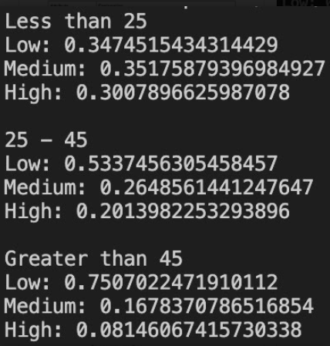
Development
Domain & Statistics
Wrote a script to easily summarize raw Compas data, show attribute classifications, etc
Focused research on mitigating bias in pre- and post-processing algorithms
Broke down algorithms and provided context to improve understanding
Discussed trade-offs which must be considered when analyzing methods which provide modular success

Slide 3
Project Direction Discussion
We understand the grand idea
Prove recidivism algorithms can be debiased and made viable
As discussed, this is likely out of the classes’ scope
What is the actual goal
What is the final deliverable
How should we be working towards this goal in our remaining two months

